Slide 1
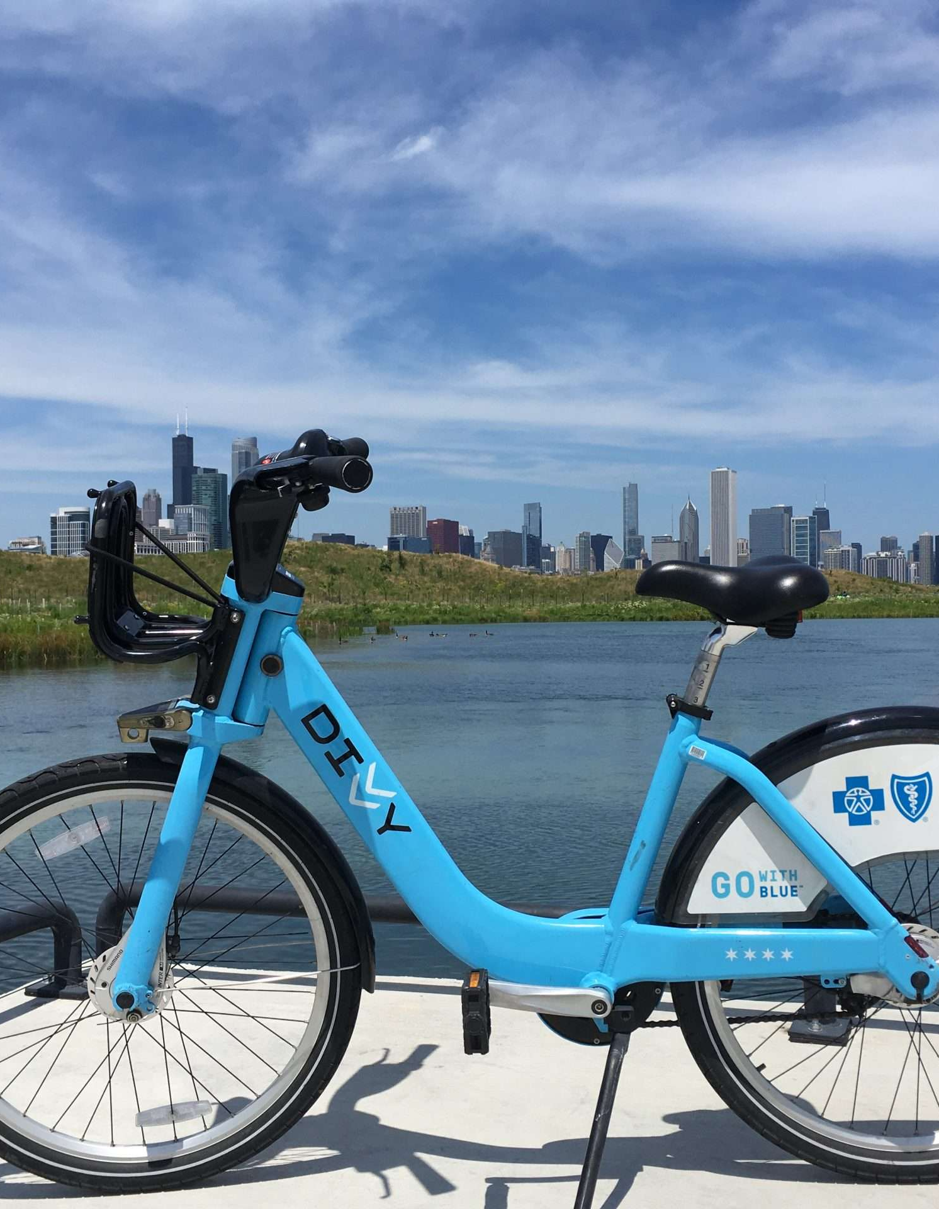
Pedals & Pathways: A Strategy to Capture Commuters and Urban Explorers as Loyal Members
Recommendations for Converting Casual Riders to Long-Term Customers
Donnie Minnick
January 2024
Notes:
Welcome to today’s session! Our goal is to share insights gained from analysis of our ridership and, based on those insights, recommend actions that will transition casual riders into committed, long-term members.
A story emerged from our data analysis, and we will talk about how annual memberships not only make commuting cost effective but also open up a world of urban exploration.
The practicality of commuting benefits combined with the allure of urban exploration has the potential to resonate with a wide audience, attracting both those seeking a reliable daily commute solution and those looking for exciting ways to experience their city.
Using our analysis, we will dissect the intersection of convenience and adventure offered by Cyclistic's bike-sharing service.

Slide 2
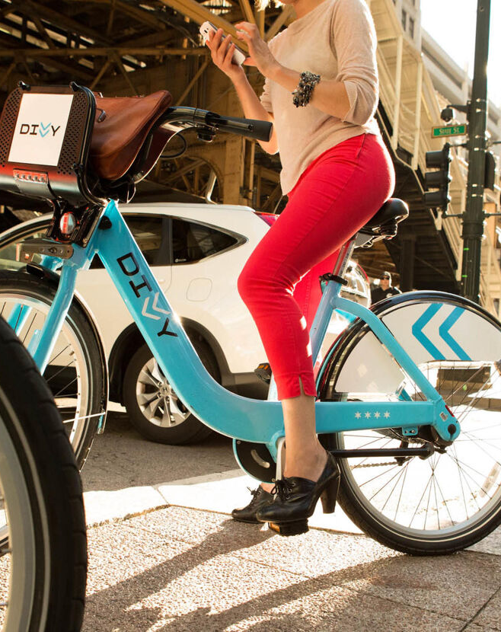
Agenda
Introduction
Business Task
Insights
Recommendations
Notes:
We will approach this conversation in five ways. We will quickly review the problem we are trying to solve and our business task, share our insights and recommendations. Along the way, we encourage everyone to interject with questions, comments and perspective. With that, let’s jump in…

Slide 3
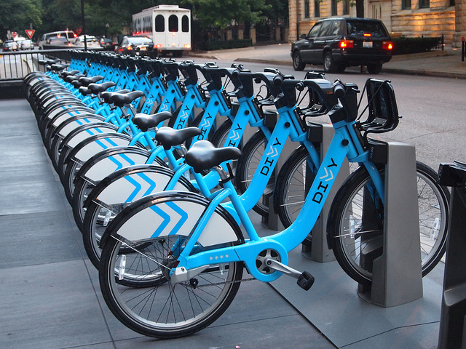
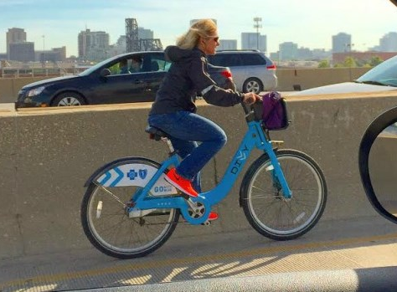
Introduction
Cyclistic, a Chicago-based bike-sharing company, operates a geotracked fleet of bicycles available throughout the city.
Cyclistic classifies riders into two types: casual riders, who purchase single-ride or full-day passes, and members that subscribe to annual memberships.
While offering flexible purchase options attracts customers, Cyclistic's finance department has concluded that members are more profitable than casual riders and need insights to help them develop a conversion strategy.
Notes:
As a quick review, we are a Chicago-based bike-sharing service with two basic types of customers, casual riders who purchase single-ride or day passes, and members, who have subscribed to annual memberships. We know, based on recent finance analysis that annual members are more profitable than casual riders, and so we want to find opportunities to convert casual riders to member status.

Slide 4
Business Task
Cyclistic's marketing team plans to develop marketing strategies to increase profits by converting casual riders to annual members. To help the marketing team understand this opportunity, analysis will focus on three questions.
How do annual members and casual riders differ?
Why might casual riders buy an annual membership?
How might Cyclistic use digital media to influence casual riders to become members?
Notes:
So our business task is to use our ridership data to answer three questions to inform marketing strategies that will enable this conversion and increase profits. We want to know how casual riders are different from members, what might incent casual riders to buy an annual membership, and how we might use digital media to influence this shift.

Slide 5
Notes on Source Data
Used first-party data from Cyclistic that captures individual trip details.
Covers same-day trips taken between January 1, 2022 and December 31, 2022.
Used random sample of 250,000 trips from population of 5,667,717.
Data cleaned and transformed to address missing values, inconsistencies, duplicates and create categorical variables for analysis.
Supplemented with shape files from the Chicago Data Portal for geographical analysis.
Notes:
Before we jump into the analysis and insights, we’d like to briefly review the source data we used for this analysis.
We used first-party company data that captures individual trip details for same-day trips taken in 2022.
We chose a random sample of 250,000 trips from a population of 5,600,000 trips.
We cleaned and transformed that data and supplemented it with additional data obtained from the Chicago Data Portal in order to incorporate geographical analysis.

Slide 6
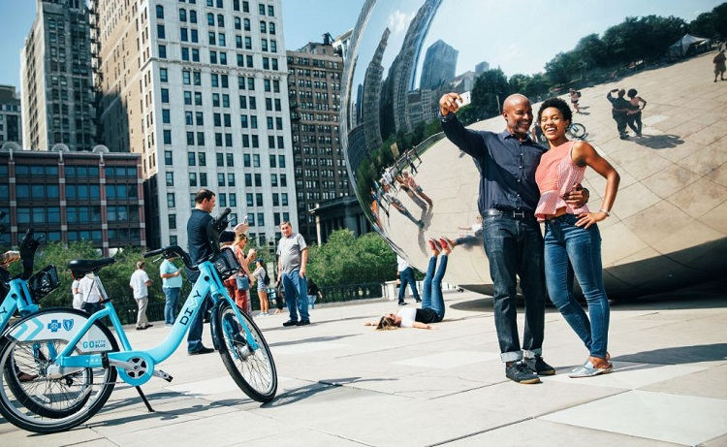
Our Big Idea
Attracting both those seeking a reliable daily commute solution and those looking for exciting ways to experience their city is the best strategy for converting casual riders to members.
Notes:
Our analysis tells us that a marketing strategy that incorporates a dual focus commuting benefits and the concept of urban exploration is the best way to appeal to a diverse range of potential members.

Slide 7
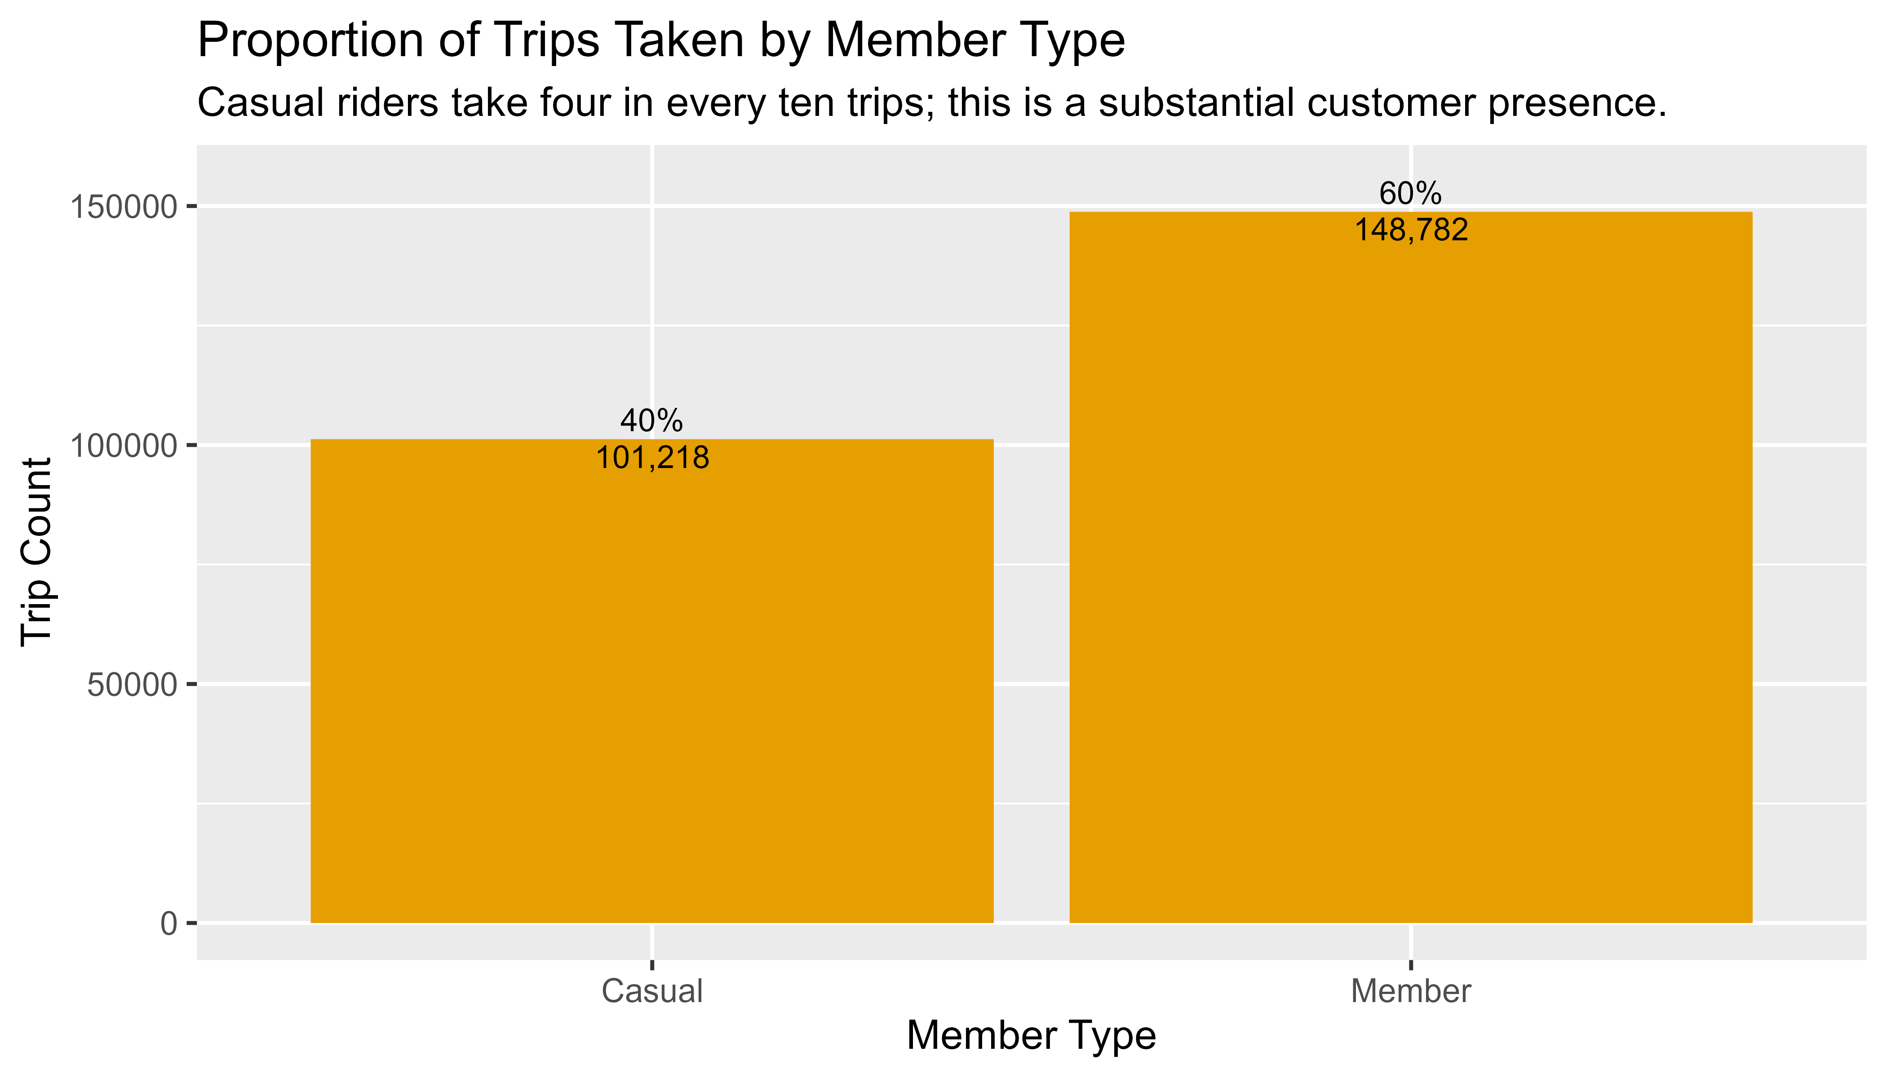
Four in every ten trips are taken by casual riders
Notes:
We found that four in every ten trips (40%) are taken by casual riders. This 40% proportion indicates a substantial presence of casual riders within the customer base.
What might this mean?
This might suggest that a considerable portion of Cyclistic's customers prefer a pay-as-you-go or occasional usage model rather than committing to a long-term membership.
Or, it might mean that annual members, contributing 60% of the trips, are more actively engaged with the bike-sharing service. This higher proportion could indicate that annual members use the service more consistently or for a broader range of purposes.
What opportunities does this present?
Considering the proportion of casual riders, Cyclistic might explore increasing the attractiveness of membership options as a way to enable conversion to member status.

Slide 8
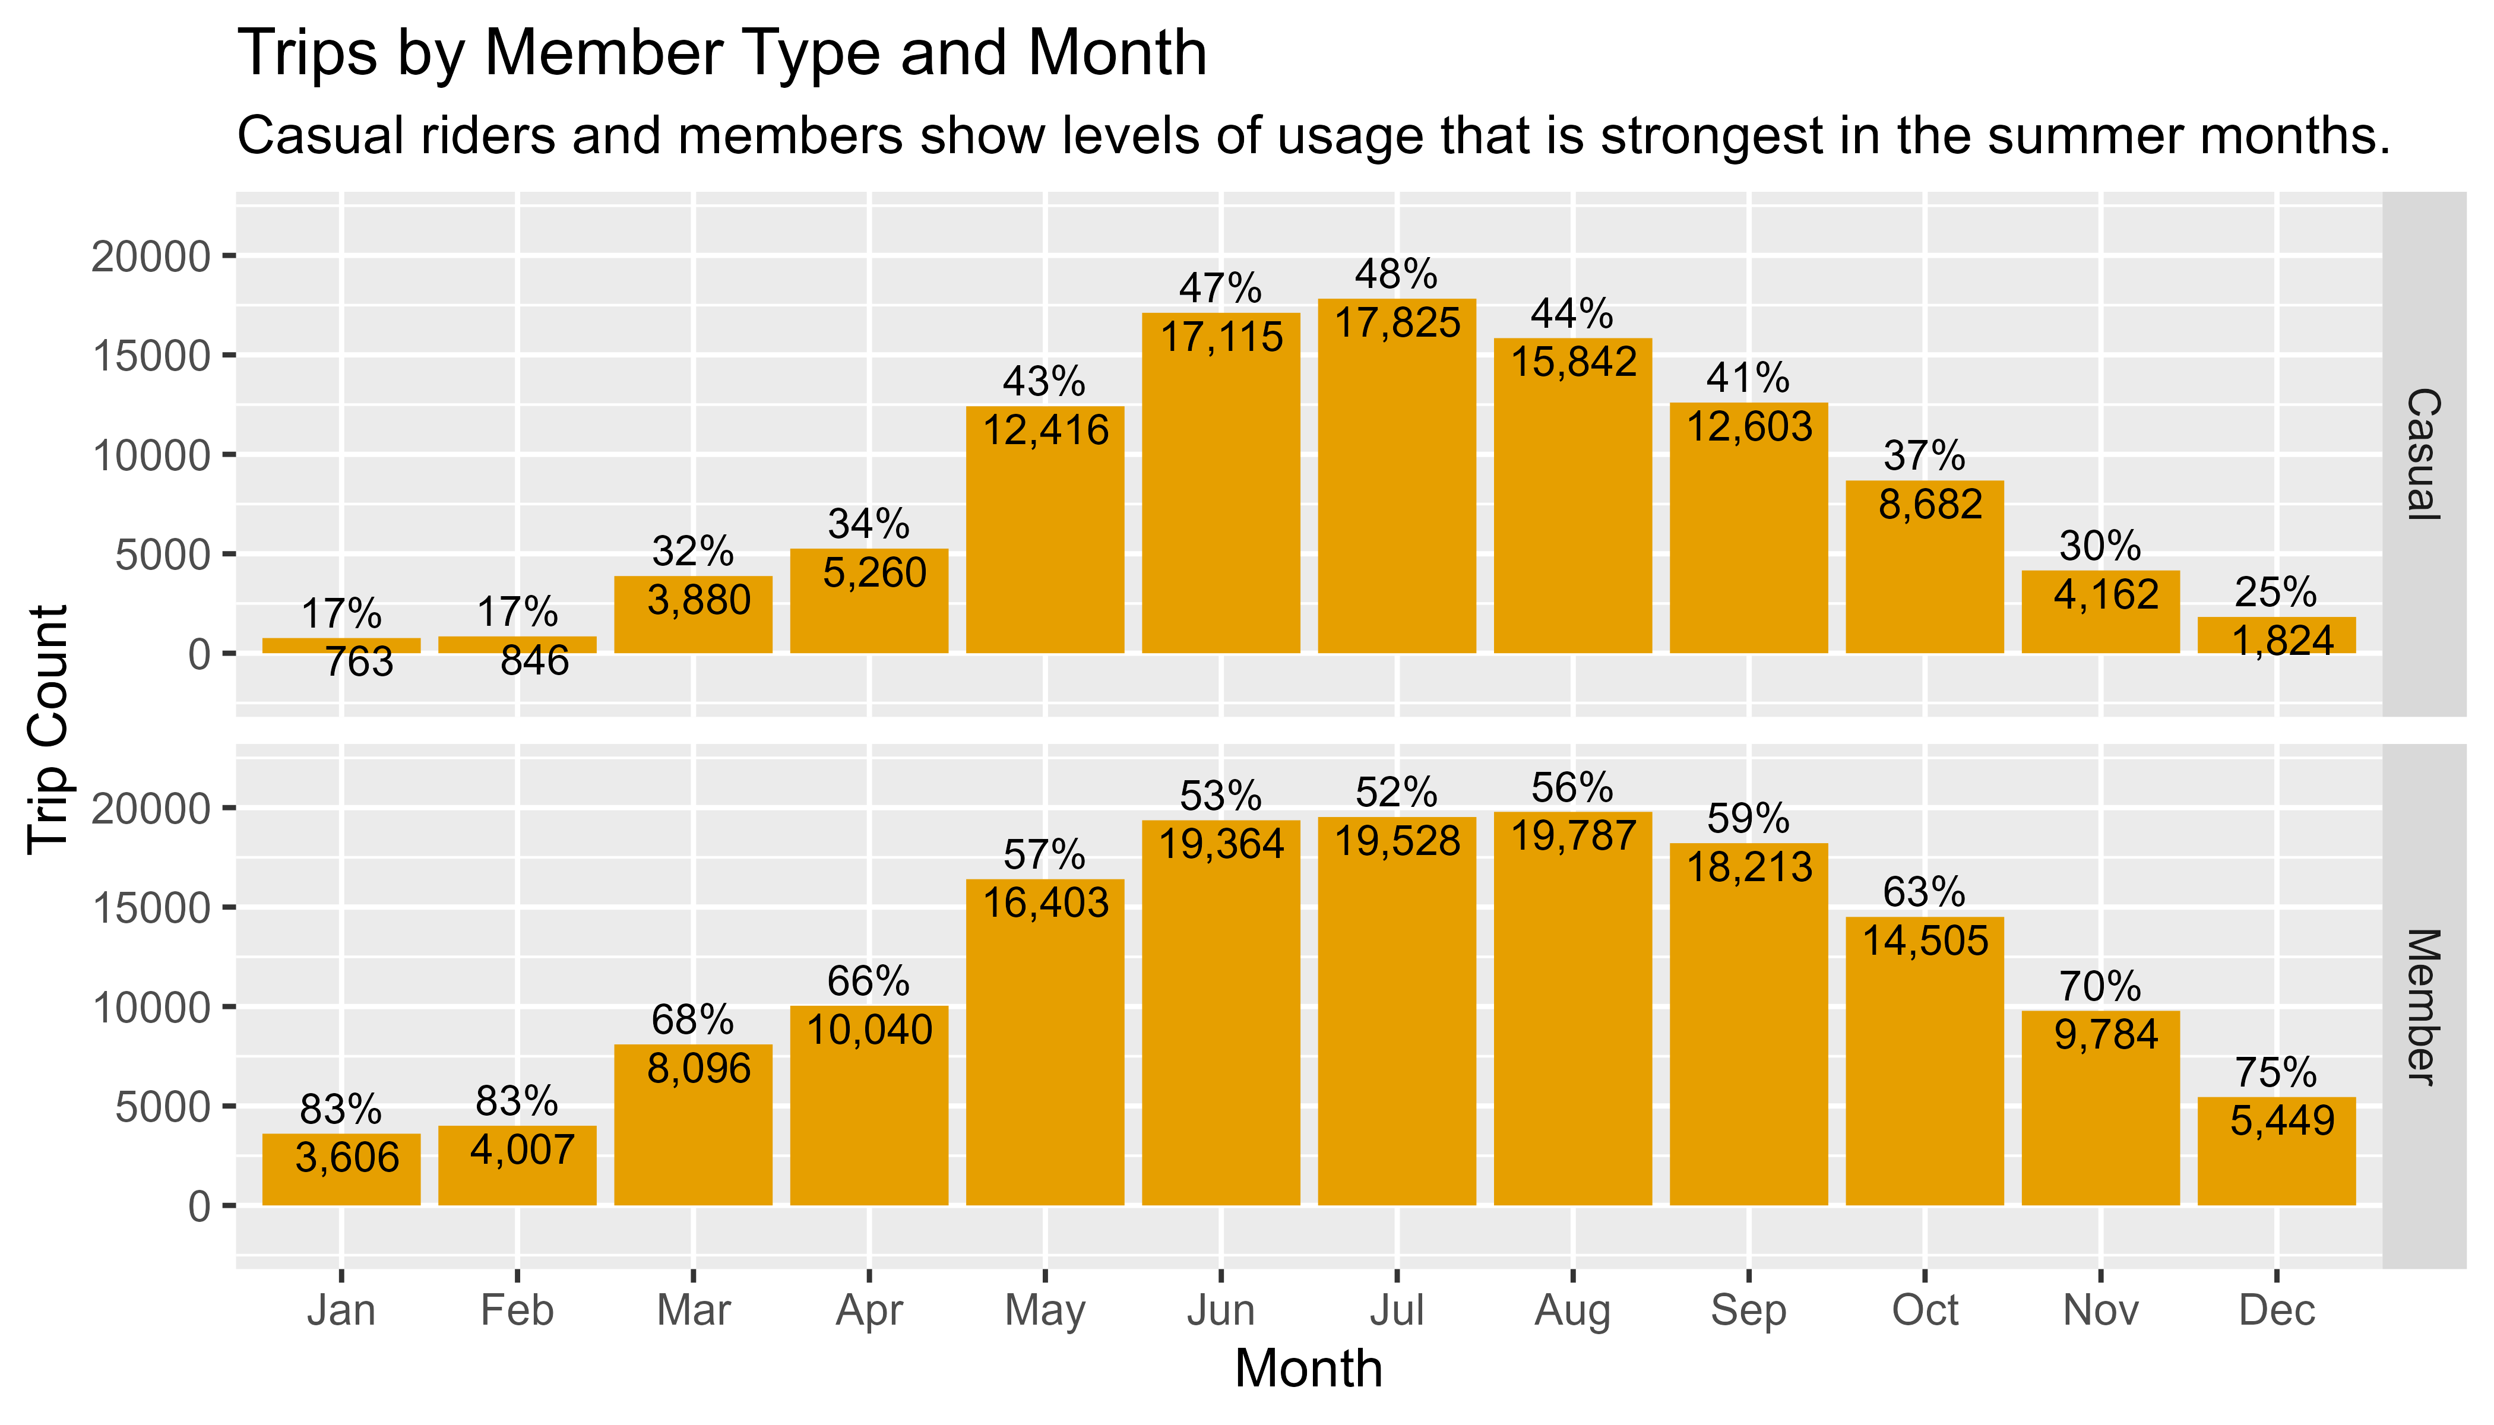
Customer engagement with the service is strongest in the summer months
Notes:
There is a trend of increased usage, by casual riders and members, during the warmer months (May through September), highlighting a seasonality effect in which people are more inclined to use bike-sharing services in favorable weather.
We noted that, throughout the entire year, members consistently contribute to the majority of trips, with proportions ranging from 52% to 83%.
Casual ridership varies more compared to members, with the proportion of trips taken by casual riders ranges from 17% to 48%, suggesting fluctuations in the demand from this group.
What opportunities does this insight present?
If we are going to focus on converting casual riders into members, months where member usage is rising or particularly high can serve as the best opportunities, since overall engagement with the service is strongest during these periods.

Slide 9
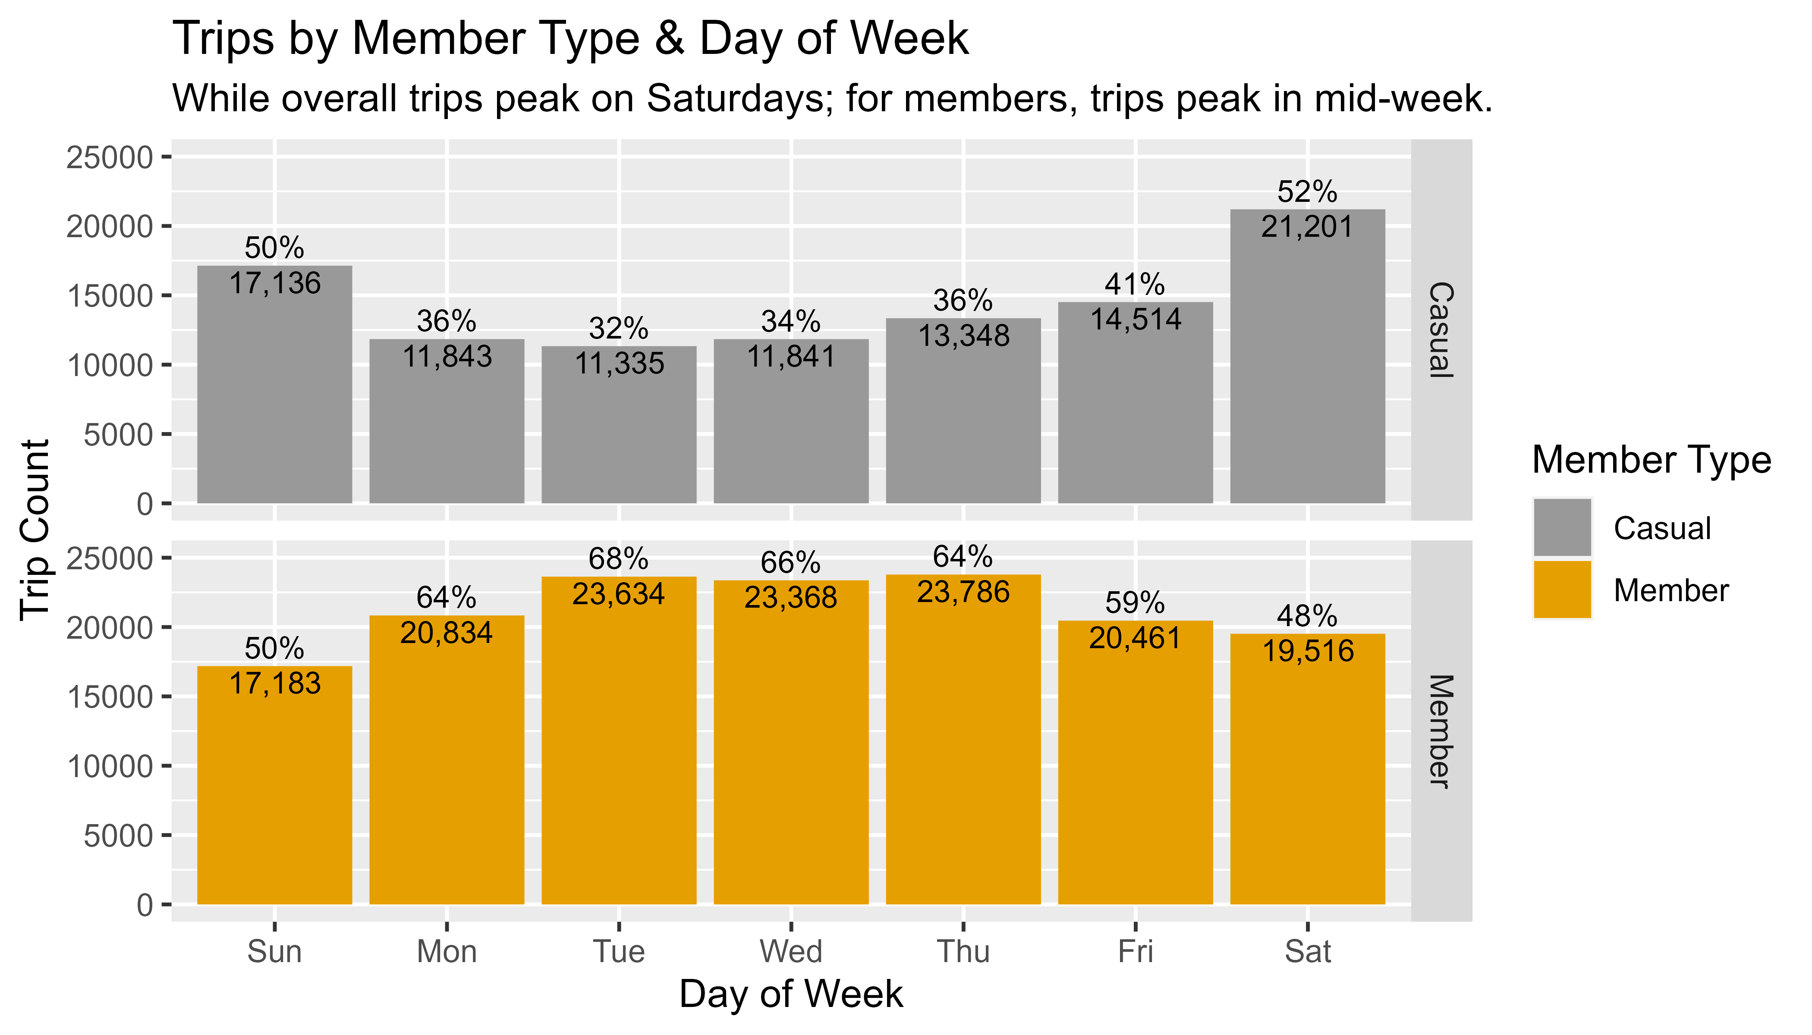
While weekdays are a peak period for members, weekends are a peak period for casual riders
Notes:
Casual riders show a notable increase in trip counts on Saturdays and Sundays, indicating that weekends are the peak period for this customer type.
Weekday usage for casual riders is low compared to weekend days and remains relatively consistent, with Monday through Thursday showing similar trip counts.
On the other hand, weekdays, particularly Tuesday through Thursday, have the highest trip counts for members.
Members show a decline in trip counts on Saturdays and Sundays, with Saturday having the lowest trip count among all days.
We believe this data highlights a need for dual focus that addresses both commuting and recreation.
To substantiate this, we did two things: 1) examined the daily pattern of trips by day, and 2) examined the duration of trips.

Slide 10
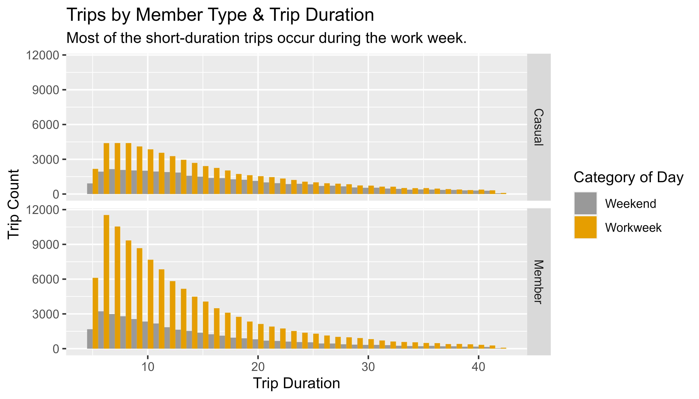
For longer trips, casual riders and members have comparable usage patterns
Notes:
These chart shows that members have a higher volume of trips with a duration of less than twenty minutes.
For trips with duration of twenty minutes or greater, casual riders and members have roughly the same volume.
The charts also demonstrate that most of the short-duration trips, regardless of customer type, are occurring during the work week. And most of these short-duration trips are taken by members.
What might account for this difference?
Members, by virtue of their membership commitment, may feel more inclined to use the service frequently for various purposes, including short trips. The subscription model encourages regular usage among members.
The similarity in frequencies after twenty minutes could indicate that, for longer trips, both casual riders and members have comparable usage patterns.
Longer trips may involve more leisurely rides or journeys to destinations farther away.
Beyond twenty minutes, the factors influencing bike-sharing usage may become more uniform between casual riders and members.
Both customer types may share a similar interest in using bikes for leisure, exercise, or exploring areas that require a longer travel time.
We can emphasize and promote the benefits of membership, especially for short trips, to encourage casual riders to consider becoming members. This could include highlighting cost savings, convenience, and additional perks for frequent users.
Tailor marketing strategies based on trip durations.
For shorter trips, focus on promoting the efficiency and time-saving aspects of the service, while for longer trips, emphasize the leisure and exploration benefits.

Slide 11
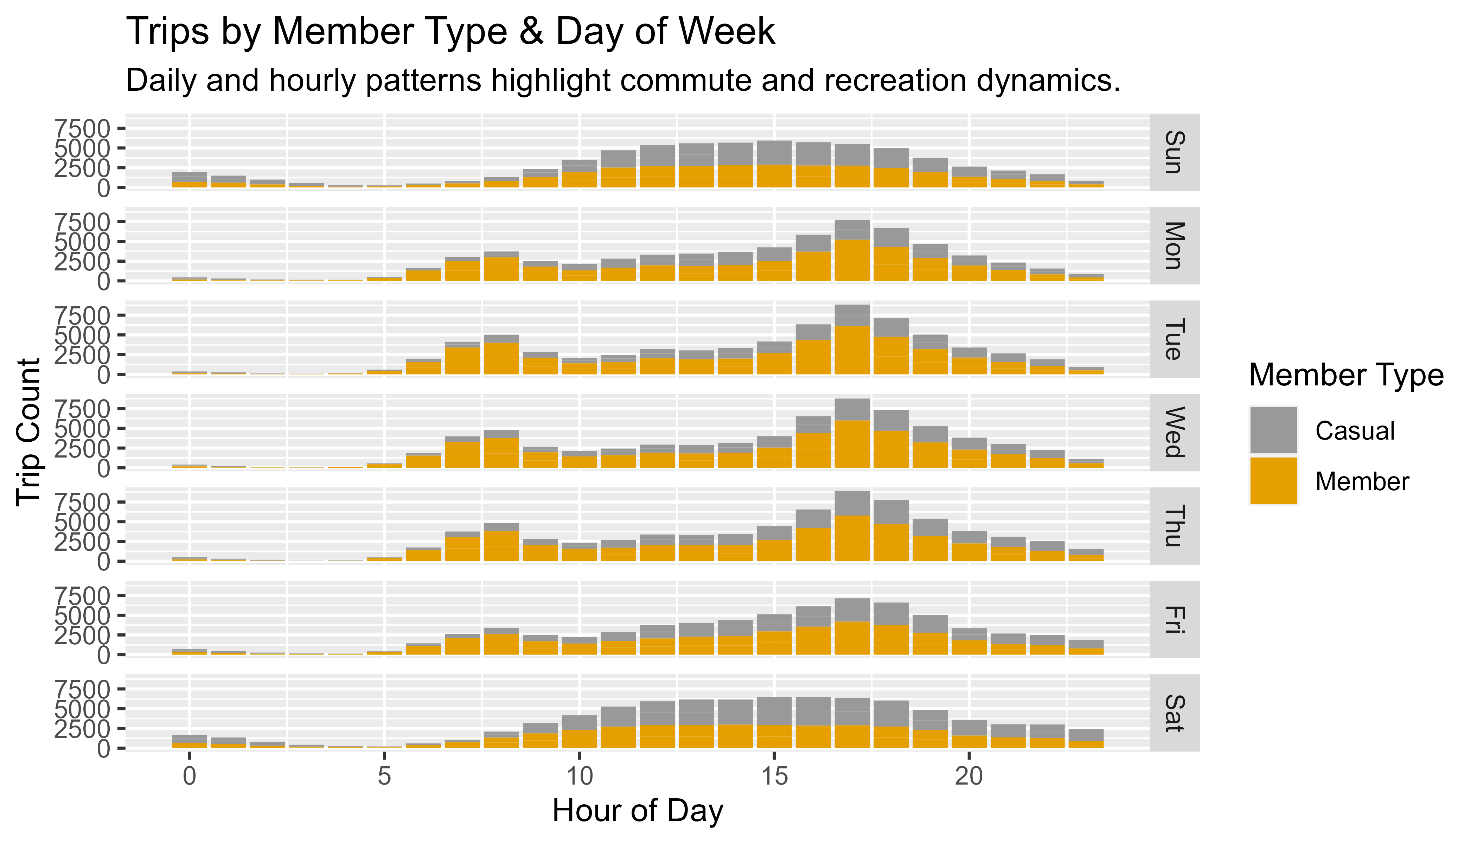
Daily and hourly patterns highlight commute and recreation dynamics
Notes:
When we examine trips by day of the week, we noted that peak hours for bike-sharing usage across weekdays are typically between 7:00-9:00 am and 4:00-6:00 pm.
Weekdays show a distinct pattern with two peaks corresponding to morning and evening commuting hours.
These periods coincide with typical commuting times, suggesting that a significant portion of trips is related to daily commuting activities.
On weekends, the usage pattern is more evenly distributed throughout the day, with a single peak in the afternoon.
During the week, a larger proportion of trips are taken by members, and on weekends, there is roughly equal proportions of activity by casual riders and members.
What does this suggest?
For those casual riders who are using the service for commutes, we can highlight member benefits to encourage membership subscriptions. We can consider offering incentives, promotions, or discounts during these hours to encourage more casual riders to use the bike-sharing service for their commute.

Slide 12
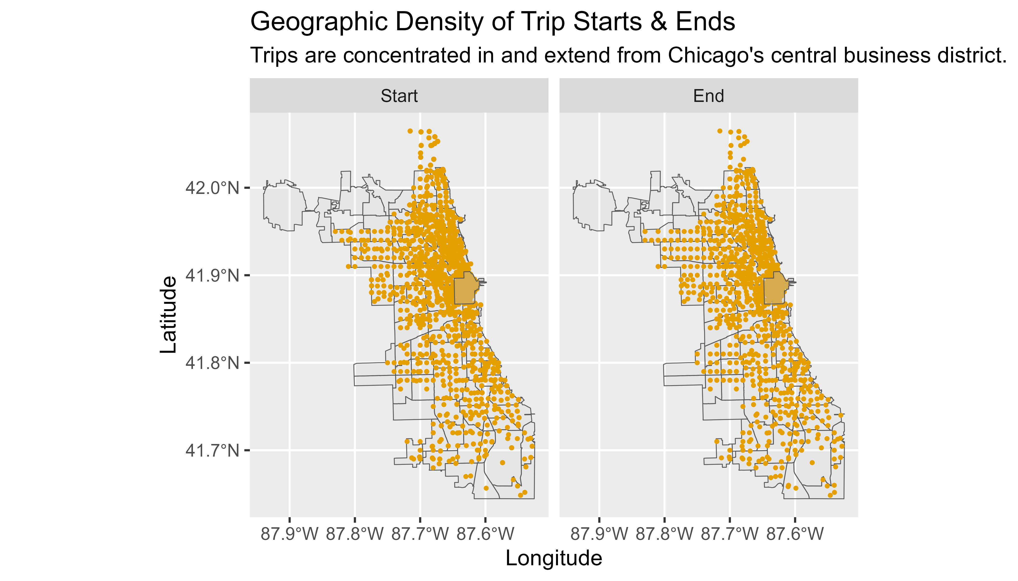
Bike-sharing activity is concentrated in and extends around the central business district
Notes:
The concentration of bike-sharing activity in and around Chicago's central Business District (CBD) suggests that the bike-sharing service is heavily utilized in areas where people work, conduct business, or engage in commercial and recreational activities.
Many trips could be associated with commuting to and from workplaces in the CBD, or users may be utilizing bikes for business-related purposes, such as meetings or appointments.
The CBD may also serve as a hub for recreational activities and tourist attractions.
The widespread distribution of trip starts and ends throughout the entire Chicago area indicates that bike-sharing is not limited to a specific region but is accessible and used across various neighborhoods and communities.
Trips starting and ending in diverse locations suggest that bike-sharing is not solely a commuting service.
Residents in different neighborhoods may use it for local transportation.
Bike-sharing might be popular among tourists exploring different parts of the city.
The service may be well-integrated into the city's transportation network, facilitating point-to-point travel.
The combination of concentrated activity in the CBD and dispersed trips across the city suggests the bike-sharing service caters to diverse needs, including commuting, recreation, and local transportation.
Bike-sharing can serve as a solution for last-mile connectivity. Identify transportation hubs, such as train stations or bus stops, and strategically place bike-sharing stations to facilitate seamless travel for commuters completing the last leg of their journey.
If trips are dispersed throughout the city, consider targeting tourism hubs and popular attractions.
Promote bike-sharing as a convenient and eco-friendly way for tourists to explore the city's diverse neighborhoods and landmarks.

Slide 13
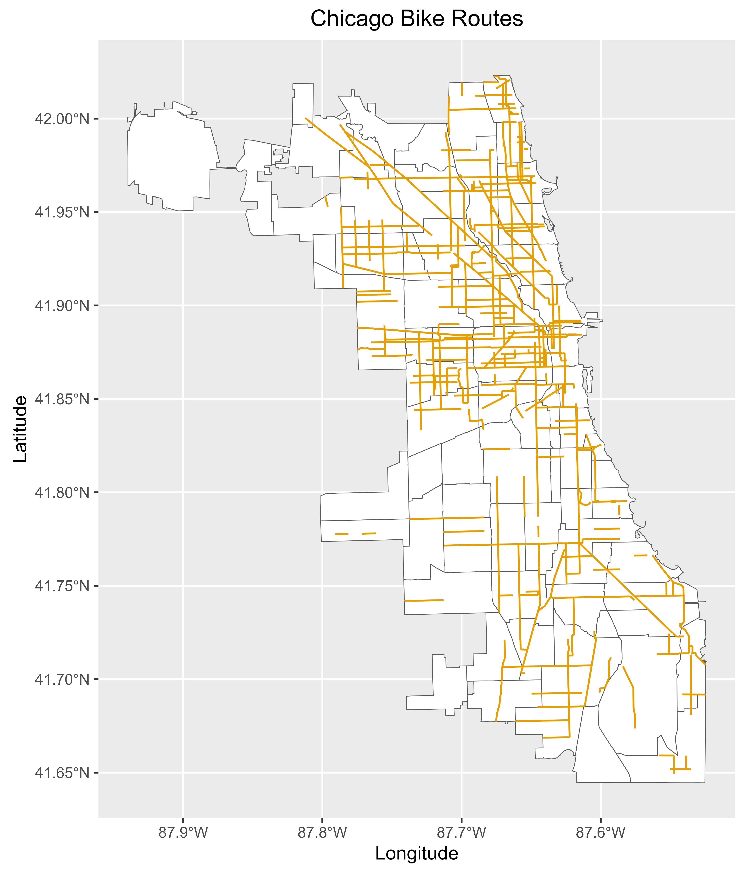
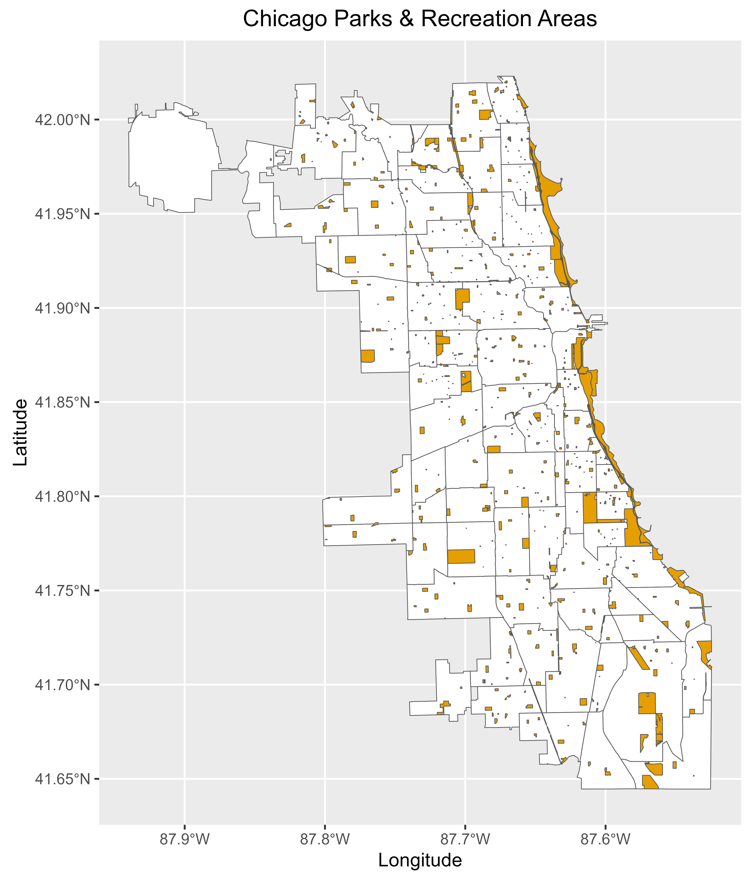
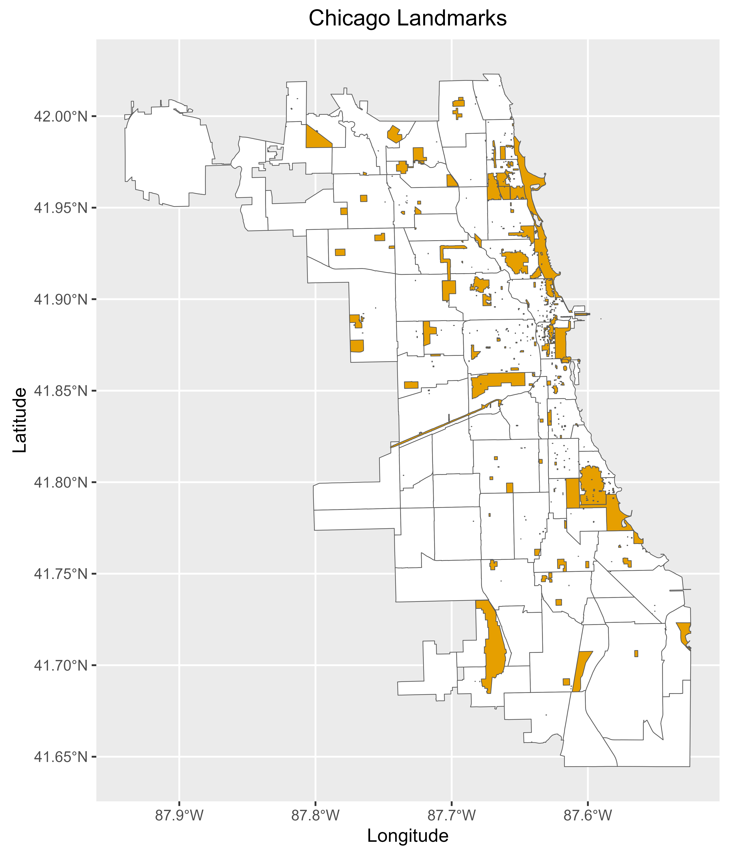
Chicago provides a multitude of opportunities for for urban adventure
Notes:
There are 953 bike routes covering 369 linear miles.
The extensive network of bike routes indicates a high level of connectivity, making it feasible for users to navigate through various parts of the city using bikes.
The well-connected infrastructure contributes to the attractiveness of bike-sharing, as users can travel efficiently and safely.
There are 8,868 acres of parks providing a broad range of recreation opportunities.
Bike routes that traverse parks often offer scenic and enjoyable paths. Cyclists can experience a more pleasant and aesthetically pleasing journey, making biking a more enjoyable and attractive mode of transportation.
There are 635 local and national landmarks of cultural significance.
The concentration of landmarks and national landmarks suggests focal points of interest and cultural significance.
These central locations create opportunities for bike-sharing services to cater to tourists, residents, and event-goers who may want convenient and sustainable transportation options to explore these landmarks.

Slide 14
Showcase the vibrant experiences of commuting and urban exploration with Cyclistic
Storytelling & Sharing
Business Partnerships
Promotions
Use storytelling in marketing materials, social media, and promotions to inspire a sense of adventure and curiosity among casual riders.
Encourage customers, especially annual members, to share their commuting and exploration experiences on social media.
Use customer-generated content to showcase real-life stories and adventures.
Develop partnerships with local businesses or organizations to offer additional perks for members, such as discounts or exclusive access to certain services and incentivize casual riders to make the switch.
Organize urban adventure events in partnership with local businesses.
Organize themed rides or events highlight unique landmarks, cultural hotspots, and hidden gems to make the experience of urban exploration both enjoyable and educational.
Use value-added guides or curated routes for annual members, showcasing the best routes for urban exploration.
Notes:
Craft compelling narratives to ignite curiosity among casual riders through storytelling in marketing, social media, and promotions.
Foster community engagement by encouraging customers, especially annual members, to share their biking experiences on social media, creating authentic content that showcases real-life stories and adventures.
Establish partnerships with local businesses to provide exclusive perks, discounts, and services for members, incentivizing casual riders to transition.
Organize urban adventure events and themed rides, highlighting unique landmarks and cultural hotspots, while offering value-added guides for annual members to enhance their urban exploration experience.

Slide 15

"Pedal through city streets, turning your daily commute into an urban adventure. Bike-sharing is the key to practicality and exploration—unlock the city with every turn."
—Cyclistic Analytics Team

Slide 16
Analysis Artifacts & Documents
Detailed analysis notebooks can be found on Rpubs here.
Notes:
You can use the links on this page to address our analysis artifacts and documents.

